Slide 1
DATA SCIENCE FOR ECONOMISTS
ECON 220 LAB
Jafet Baca-Obando
Week 11, Hypothesis Testing – 11/07/2025

Slide 2
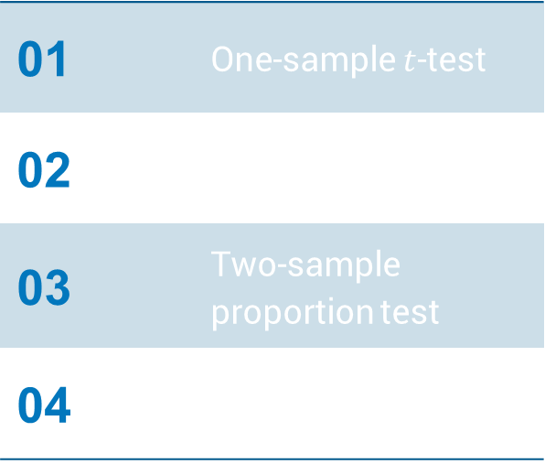
Outline
01 | One-sample $t$-test
02 | Two-sample $t$-test
03 | Two-sample proportion test
04 | Chi-squared test

Slide 3
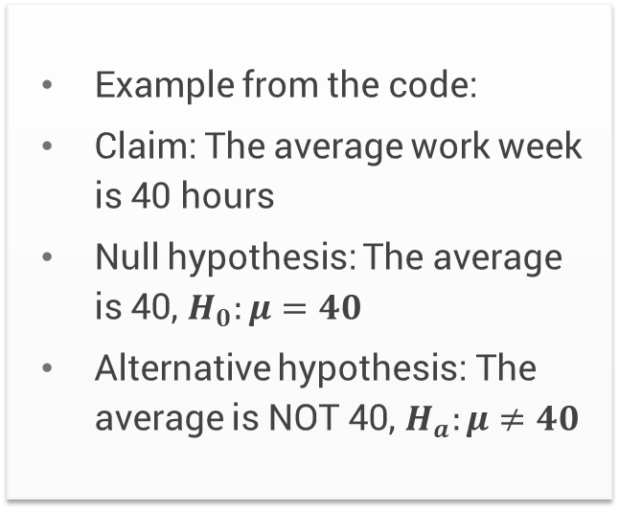
One-sample 𝑡-test
This test checks if the mean (average) of a single group is equal to a specific, known value.
It's used to test a claim about a population average.
Example from the code:
Claim: The average work week is 40 hours
Null hypothesis: The average is 40, $H_{0}:μ=40$
Alternative hypothesis: The average is NOT 40, $H_{a}:μ≠40$

Slide 4
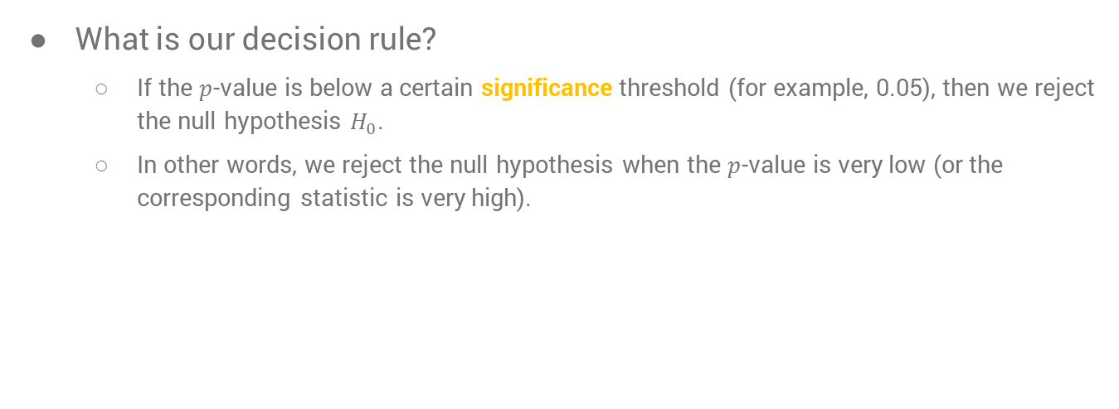
One-sample 𝑡-test
What is our decision rule?
  If the $p$-value is below a certain significance threshold (for example, 0.05), then we reject the null hypothesis $H_{0}$.
  In other words, we reject the null hypothesis when the $p$-value is very low (or the corresponding statistic is very high).

Slide 5
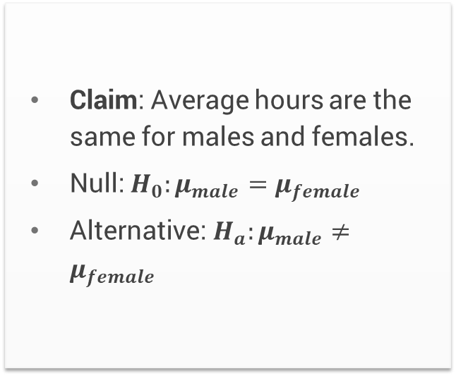
Two-sample 𝑡-test
This test compares the means (averages) of two independent groups to see if they are different from each other.
For example, are the average hours worked for men and women different?
Claim: Average hours are the same for males and females.
Null: $H_{0}:μ_{male}=μ_{female}$
Alternative: $H_{a}:μ_{male}≠μ_{female}$

Slide 6
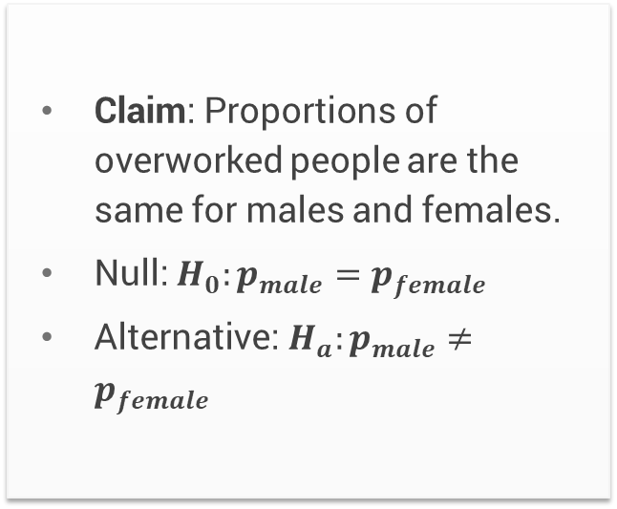
Two-sample proportions test
This test compares the proportions of two independent groups to see if they are different.
For example, is the proportion of overworked people the same for males and females?
Claim: Proportions of overworked people are the same for males and females.
Null: $H_{0}:p_{male}=p_{female}$
Alternative: $H_{a}:p_{male}≠p_{female}$

Slide 7
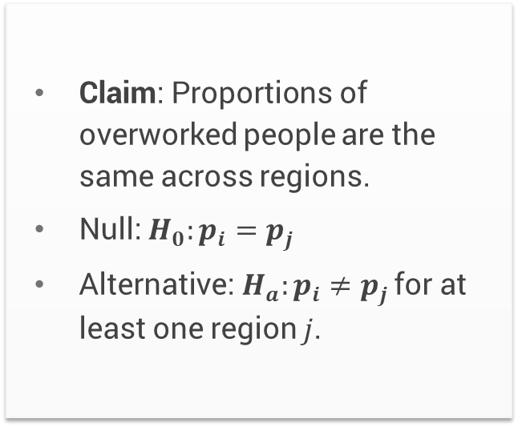
Chi-squared test
This test is used to compare proportions across more than two groups. It checks if there is a significant association between two categorical variables.
Question: Is the proportion of "overworked" people different across the 4 U.S. regions?
Claim: Proportions of overworked people are the same across regions.
Null: $H_{0}:p_{i}=p_{j}$
Alternative: $H_{a}:p_{i}≠p_{j}$ for at least one region $j$.

Slide 8
Summary of tests
One-sample 𝑡-test
Compares one group's mean to a known value. (e.g., Avg. hours vs. 40)
Two-sample 𝑡-test
Compares two groups' means to each other. (e.g., Male vs. Female avg.)
Two-sample proportions test
Compares two groups' proportions. (e.g., Male vs. Female "overworked" %)
Chi-squared
Compares proportions across *more than two* groups. (e.g., "Overworked" % by Region)

Slide 9
To-do list
Complete Data Exercise 7
  Upload Jupyter notebook (.ipynb file) and HTML file on November 9
Complete Data Exercise 8
  Upload Jupyter notebook (.ipynb file) and HTML file on November 16

